Slide 1
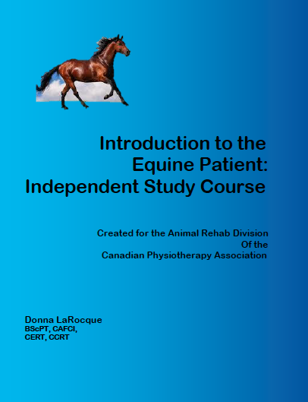
The Animal Rehab Division presents:
INTRODUCTION TO THE EQUINE PATIENT
Created by Donna LaRocque, BScPT, CAFCI, CCRT, CERT
This program is an INDEPENDENT STUDY COURSE. It consists of a 175 page manual with topics on:
Introduction to the Equine Patient
Anatomy of the Equine Forelimb
Anatomy of the Equine Hindlimb
Anatomy of the Equine Spine
Orthopaedic Conditions of the Horse
Neurologic Conditions of the Horse
Gait Patterns of Horses
Behaviour and Handling of the Equine Patient
Occupational Health Considerations for Working with Animals
Common Equine Medications & Nutraceuticals
Legal Issues, Politics, & Practice
This course is designed for physiotherapists with an interest in animals. It includes a multiple choice exam, designed to assist you with your learning of this material, and upon successful completion of the exam (with a grade of 85% or better) you will receive a certificate of completion. The course materials will serve as the prerequisite for physical therapists wanting to take the Introduction to Equine Rehabilitation Course in the future.
All material can be learned from the comfort of your own home, completed at your own pace, and reviewed as often as you like!
Questions can be sent to animalrehab@physiotherapy.ca
To Register go to ard.rostertrack.com
Cost
ARD-Member $300.00 + GST+PST or HST + $25.00 S & H
Non-Member $375.00 + GST+PST or HST + $25.00 S & H
Pre-Requisites
Registered or retired Canadian physiotherapists or students in their final year of a Canadian Physiotherapy Program

